Slide 1
The Common Ion Effect
November 2016

Slide 2
RECALL:
Solubility is the maximum amount of solute that can be dissolved in a given volume of solution.
The solubility of a substance is decreased by the addition or presence of a common ion. This is called the common ion effect.

Slide 3
Examples of the Common Ion Effect: in the presence of a common ion
1) Solid BaSO₄ is added to a solution of 0.10M Na₂SO₄.
Which ion is the common ion?
Since BaSO₄ is much less soluble than Na₂SO₄, we will only consider the solubility of BaSO₄ .
BaSO_{4(s)} ←→ Ba²⁺_{(aq)} + SO₄²⁻_{(aq)}
Create an ICE chart that reflects the above information.
What is the molar solubility of BaSO₄ in the Na₂SO₄ solution?
What is the molar solubility of BaSO₄ in water?
What effect does the presence of a common ion have on the solubility of BaSO₄?

Slide 4
Examples of the Common Ion Effect: addition of a common ion
2) 0.010 mol of NaCl_{(aq)} is added to 1L of a saturated solution of AgCl.
Which ion is “common” to both solutions?
Since AgCl is less soluble than NaCl, we will consider its solubility.
AgCl_{(s)} ←→ Ag⁺_{(aq)} + Cl⁻_{(aq)}
What will increasing the [Cl⁻] do to the solution of AgCl?
What will the new [Ag⁺] be?

Slide 5
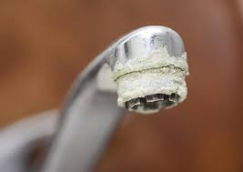
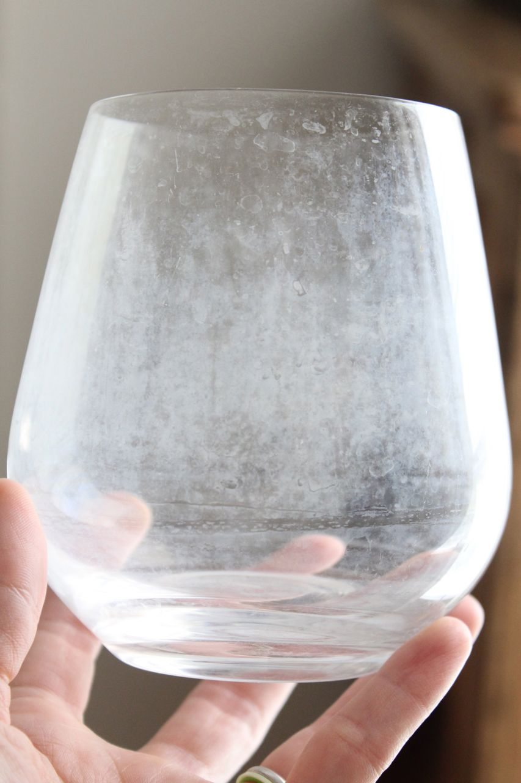
Everyday example of the common ion effect: Hard water

Slide 6
Hard Water
Water is said to be hard when it has a relatively high concentration of calcium and magnesium carbonates.
Effects of hard water:
Doesn’t allow soap to dissolve → soap curds that stick to everything - skin, dishes, clothes, bathtub
need to use more soap
Clogs up plumbing as deposits of these carbonates form on taps, pipes, appliances

Slide 7
Water hardness can be reduced by adding sodium carbonate to the water.
CaCO_{3(s)} ←→ Ca²⁺_{(aq)} + CO₃²⁻_{(aq)}
What does the addition of carbonate ions from the sodium carbonate cause?

